Slide 1
Managing Sequence of Returns Risk
Hosted by:
NAME, Title
Your Address Here | Office: 555-555-5555 | Fax: 555-555-5555 | YourWebsiteHere.com

Slide 2
This material contains general information to help you understand basic retirement income strategies.
Throughout the presentation, we may generally discuss different insurance products; however, nothing I say should be construed as a recommendation to buy or sell any insurance product, nor should it be used to make decisions today about your current retirement income strategy. Insurance product guarantees are backed by the financial strength and claims-paying ability of the issuing company.
My goal with this presentation is to expose you to ideas and insurance products that may help you work towards your retirement income goals. Please understand that I cannot make any promises or guarantees that you will accomplish such goals.
This presentation is designed to provide general information on the subjects covered. It is not, however, intended to provide specific legal, tax or investment advice and cannot be used to avoid tax penalties or to promote, market, or recommend any tax plan or arrangement. Please note that DMI and its representatives do not give legal, tax or investment advice. Legal, tax and investment advice should come from a licensed professional who can provide advice on these topics.
The presenter, speaker and sponsor of this seminar as well as the information presented at the seminar is not related to, endorsed by, connected with or approved by any government agency or organization. For information regarding your Social Security benefits, you are encouraged to speak to your local Social Security Administration office or visit the Social Security Administration website at www.ssa.gov.
Despite efforts to be accurate and current, this presentation may contain out-of-date information; we are under no obligation to advise you of any subsequent changes related to the topics discussed in this presentation. Insurance products involve restrictions, terms, fees and charges and may not be suitable for everyone. Carefully read all product information before making a purchasing decision.

Slide 3
What is a Bear market?
No one can predict how the markets will perform, historically a bear market has occurred about once every 3.5 years and lasted an average 367 days.¹
Chances are good that you will experience a bear market at least once – and possibly more – during a retirement that lasts on average 12 years.²
It takes an average of 26 months after a bear market for the stock market to battle back to where it stood at the beginning.³
Your best bet is to ensure you have a careful strategy to help mitigate the effects of a bear market and help avoid running out of money.
1 https://www.thebalance.com/u-s-stock-bear-markets-and-their-subsequent-recoveries-2388520 2 https://www.gobankingrates.com/retirement/planning/jaw-dropping-stats-state-retirement-america/ 3 https://awealthofcommonsense.com/2020/03/how-long-does-it-take-to-make-your-money-back-after-a-bear-market/

Slide 4
What is the Sequence of Returns Risk?
Retiring or approaching retirement in or near a bear market means that you need to think about the risk of experiencing losses in your portfolio just as you retire.
Withdrawing money from your portfolio while it’s declining in value can dramatically impact its ability to last throughout your retirement.
In the examples on the next pages, simply reversing the order of the returns creates two vastly different outcomes depending on withdrawals.
The portfolio with ‘early losses’ is depleted by year 17 while the portfolio with ‘reversed returns’ lasts for 30 years and increases in value.
Same returns, different order.

Slide 5
Why the Sequence of Returns Matter
The Sequence of Returns may have less of an impact on the portfolio of a long-term investor who is no longer putting money in, nor is taking money out.
However, the relationship between an investor's rate of withdrawal and the Sequence of Returns can have a dramatic impact on a portfolio's ability to last during the withdrawal period (usually during retirement).
Notes:
What I’m going to discuss as our final point today is way people typically address that income gap by tapping into the nest egg --- which is what it is there for. So while we are working, and socking it away – it grows – we hope, basically up and down, but over enough time, UP!
A strange anomaly exists – it doesn’t matter if the market goes up then down, or down then up – so long as you don’t withdrawal any money. But remember, this is retirement, we need to withdrawal the money to live! So, let’s take a look at this sequence of returns, and how it plays out.

Slide 6
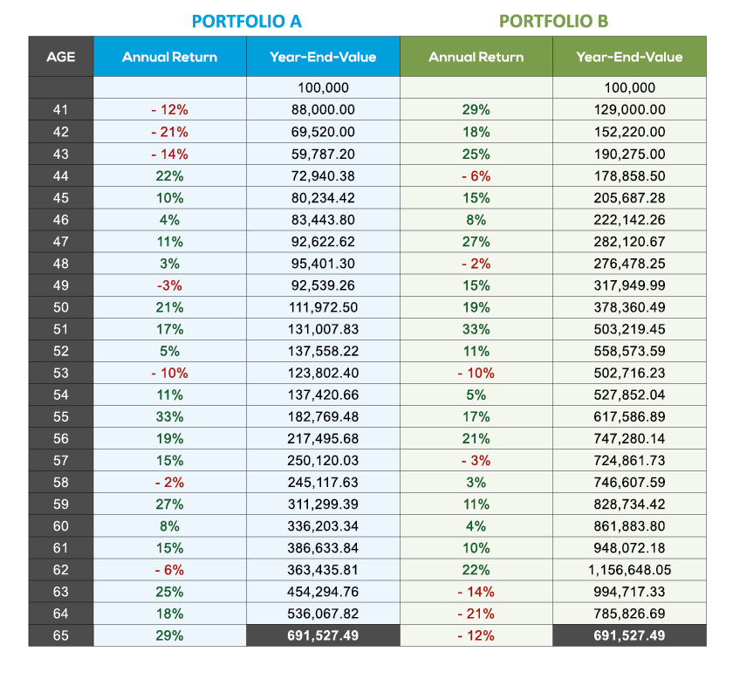
Factors Affecting Portfolio Results Before Retirement
In this example for Portfolio A & B:
starting value is $100,000
average annual return is 8%
withdrawals are $0
Value at Age 65:​
Portfolio A = $691,527.49 ​
Portfolio B = $691,527.49 ​
NOTE: This example is shown for illustrative purposes only and does not reflect any specific product or investment, nor does it reflect fees, charges or taxes which would reduce the figures shown here
Notes:
*this chart is from an internal source*
We invest $100,000 in a typical investment in the market, and we let it go for 24 years. On this slide, the ONLY difference is the Sequence of the annual returns in their portfolio. Both Portfolios have starting values of $100,000 (one-time lump sum), and both average the same 8% overall annual return, the series is just inverted.
It’s weird, it’s math, we love math!
Now let’s look at the exact same scenario, but let’s start taking 5% out each year, as we would expect to do during retirement.

Slide 7
Factors Affecting Portfolio Results After Retirement
Reversing the order of the returns while taking withdrawals creates two vastly different outcomes. The portfolio with ‘early losses’ is depleted by year 17 while the portfolio with ‘reversed returns’ lasts for 30 years and increases in value.
Same returns, different order.
Notes:
If we start taking income from our nest egg during this series of market events, which is of course, something we have to do! It’s called retirement income after all! Well, there is this massive difference in outcomes just depending on forces outside your control.
What I mean is you do all the right things, you follow all the rules, you’re no longer in control. The 4% rule states that if you stay in the market and take just 4% of your principal or earnings every year as income, there is close to a 100% chance (based on historical scenarios) you won’t run out of money for at least 30 years.* Sounds good. I’ll take those odds right down to the track.
*https://www.schwab.com/learn/story/beyond-4-rule-how-much-can-you-spend-retirement

Slide 8
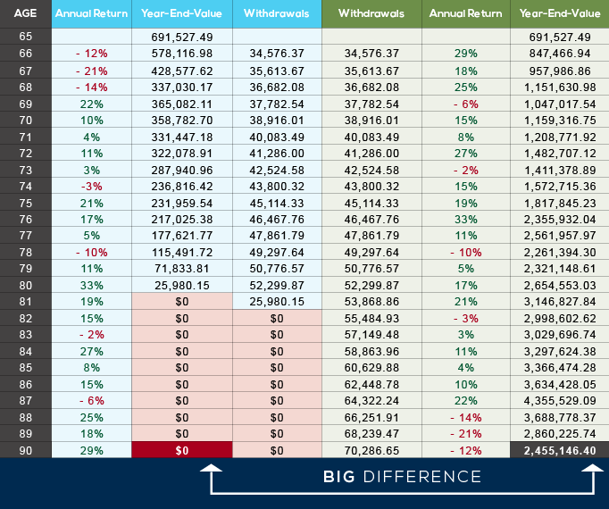
Factors Affecting
Portfolio Results
After Retirement
In this example for Portfolios A & B:
Starting value is $691,527.49
Average annual return is 8%
Annual income withdrawal is 5% of first year value, adjusted thereafter for inflation
Value at Age 90:​
Portfolio A = $0 ​
Portfolio B = $2,455,146.40​
NOTE: This example is shown for illustrative purposes only and does not reflect any specific product or investment, nor does it reflect fees, charges or taxes which would reduce the figures shown here
Notes:
*this chart is from an internal source*
However, nowadays, that’s not the case.
It's a rigid rule. The 4%-5% rule assumes you increase your spending every year by the rate of inflation—not on how your portfolio performed—which can be a challenge for some investors.
It applies to a specific portfolio composition. The rule applies to a hypothetical portfolio invested 50% in stocks and 50% in bonds. Your actual portfolio composition may differ, and you may change your investments over time during your retirement.
It uses historical market returns. Analysis by Charles Schwab projects that market returns for stocks and bonds over the next decade are likely to be below historical averages.
It doesn't include taxes or investment fees.
If you have any questions on the last section, make sure to sign up for your complimentary consultation *put up appointment pop-up*. I just have a few more important items I want to also share with you.
*https://www.schwab.com/learn/story/beyond-4-rule-how-much-can-you-spend-retirement

Slide 9
Ways to help shield your retirement against the consequences of a bear market
Create income “buckets”
Take some risk off the table
Lower your expenses during your initial years of retirement
Consider a second career
Delay your retirement
Work with a financial professional
Notes:
Create income “buckets.” Consider creating different “buckets” of money for different purposes. For example, you can create buckets of money invested in different vehicles for different purposes. Bucket one would be your more liquid assets, such as savings or money market accounts. You can take money from this bucket for income for a few years to avoid having to sell investments when the market is declining. The other buckets are for longer term needs and often involve progressively riskier investments.
Take some risk off the table. This is a good time to make sure you have a fixed income strategy in place. No one wants to rely on the ups and downs of the market for the income they need to cover their basic living expenses in retirement, so look at income sources that guarantee these needs are met. These sources could likely include social security, pensions, annuities, and other “conservative” investments such as TIPS or bonds.
Work with a financial professional. According to studies by Vanguard and Morningstar, those who worked with a good financial professional had improved financial outcomes.* Financial professionals can help you develop and implement a retirement income strategy customized for you. This will include making the right decisions for your social security and pension benefits, helping you diversify your income-producing assets, and identifying where insurance and annuity products can help fill any income gaps.
Lower your expenses during your initial years of retirement. Putting off that dream vacation or not buying that vacation home for a couple of years could help bolster your retirement portfolio and increase how long your money will last. If you’re considering moving, do some research to determine which locales will meet your retirement goals. AARP, US News and World Report, and Kiplinger frequently publish lists of the best, affordable places to retire.
Consider a second career. There are lots of options including working as a consultant in your former line of work, a part-time job at a local business, or a paid position at a favorite charity. Some organizations recognize the value of retirees and specifically target them for temporary positions. AARP has an entire network of “smart organizations that know an age-diverse workforce is good for business.” **
Delay retirement. You can avoid withdrawing money when your portfolio is down and potentially keep adding funds to your nest egg. (If you’re experiencing a bear market, you’ll be adding to your portfolio at lower prices.) In fact, one of your primary goals should be to save more during this time.
*https://smartasset.com/data-studies/benefits-of-working-with-a-financial-advisor-2021
**https://jobs.aarp.org/

Slide 10
Are Fixed Annuities a good fit for your financial strategy?
Did you know an annuity is the only financial product you can purchase that can guarantee income payments you won’t outlive.
Minimum interest guarantee⁴
Tax-deferral
Guaranteed income for life
Access to your money⁵
Withdrawal charge waivers for life’s “just in case” moments
Death benefit options
Diversification of asset strategy
No additional annual charges (unless you purchase an optional rider)
4 Minimum guarantees may be 0% but your principal is protected from market loss at all times
5 Taxable withdrawals are subject to ordinary income tax. Withdrawals taken prior to age 59½ may be subject to a 10% federal early withdrawal tax penalty. Contractual withdrawal charges may also apply.
Notes:
Create income “buckets.” Consider creating different “buckets” of money for different purposes. For example, you can create buckets of money invested in different vehicles for different purposes. Bucket one would be your more liquid assets, such as savings or money market accounts. You can take money from this bucket for income for a few years to avoid having to sell investments when the market is declining. The other buckets are for longer term needs and often involve progressively riskier investments.
Take some risk off the table. This is a good time to make sure you have a fixed income strategy in place. No one wants to rely on the ups and downs of the market for the income they need to cover their basic living expenses in retirement, so look at income sources that guarantee these needs are met. These sources could likely include social security, pensions, annuities, and other “conservative” investments such as TIPS or bonds.
Work with a financial professional. According to studies by Vanguard and Morningstar, those who worked with a good financial professional had improved financial outcomes.* Financial professionals can help you develop and implement a retirement income strategy customized for you. This will include making the right decisions for your social security and pension benefits, helping you diversify your income-producing assets, and identifying where insurance and annuity products can help fill any income gaps.
Lower your expenses during your initial years of retirement. Putting off that dream vacation or not buying that vacation home for a couple of years could help bolster your retirement portfolio and increase how long your money will last. If you’re considering moving, do some research to determine which locales will meet your retirement goals. AARP, US News and World Report, and Kiplinger frequently publish lists of the best, affordable places to retire.
Consider a second career. There are lots of options including working as a consultant in your former line of work, a part-time job at a local business, or a paid position at a favorite charity. Some organizations recognize the value of retirees and specifically target them for temporary positions. AARP has an entire network of “smart organizations that know an age-diverse workforce is good for business.” **
Delay retirement. You can avoid withdrawing money when your portfolio is down and potentially keep adding funds to your nest egg. (If you’re experiencing a bear market, you’ll be adding to your portfolio at lower prices.) In fact, one of your primary goals should be to save more during this time.
*https://smartasset.com/data-studies/benefits-of-working-with-a-financial-advisor-2021
**https://jobs.aarp.org/

Slide 11
Does Life Insurance have a place in your financial strategy?
Permanent life insurance has a cash value component that can help grow your money on a tax-efficient basis. Premiums paid in excess of the policy costs have the potential to grow without taxation each year and can be withdrawn tax-free.
A life insurance policy’s death benefit can be a source of cash for final expenses and estate settlement costs, including estate and inheritance taxes.
You may still be working! Life insurance can help replace lost income in case of your death.
Life insurance can be used to replace all, or a part of your spouse’s pension benefits in case of death.
The life insurance policy death benefit can be used to pay off mortgages or other debt.
Responsibilities don’t retire when you do.
Life insurance can help create or protect a legacy.
Your employer-sponsored group life insurance plan could retire when you do. An individual life insurance policy can help replace any group coverage you lose when you retire
Policy withdrawals or loans can be used to help supplement your retirement income.⁶
Life insurance involves fees and charges, including possible surrender penalties. It requires medical, and often financial underwriting to qualify.
6 Policy loans and withdrawals will reduce available cash values and death benefits and may cause the policy to lapse or affect any guarantees against lapse. Additional premium payments may be required to keep the policy in force. In the event of a lapse, outstanding policy loans in excess of unrecovered cost basis will be subject to ordinary income tax. Tax laws are subject to change. You should consult a tax professional.

Slide 12
Schedule your Complimentary Appointment to go over areas of Interest and Concern.
555-555-5555
*The S&P 500® Index is a product of S&P Dow Jones Indices LLC (“SPDJI”). Standard & Poor’s®, S&P®, and S&P 500® are registered trademarks of Standard & Poor’s Financial Services LLC (“S&P”). It is not possible to invest directly in an index.
Notes:
Create income “buckets.” Consider creating different “buckets” of money for different purposes. For example, you can create buckets of money invested in different vehicles for different purposes. Bucket one would be your more liquid assets, such as savings or money market accounts. You can take money from this bucket for income for a few years to avoid having to sell investments when the market is declining. The other buckets are for longer term needs and often involve progressively riskier investments.
Take some risk off the table. This is a good time to make sure you have a fixed income strategy in place. No one wants to rely on the ups and downs of the market for the income they need to cover their basic living expenses in retirement, so look at income sources that guarantee these needs are met. These sources could likely include social security, pensions, annuities, and other “conservative” investments such as TIPS or bonds.
Work with a financial professional. According to studies by Vanguard and Morningstar, those who worked with a good financial professional had improved financial outcomes.* Financial professionals can help you develop and implement a retirement income strategy customized for you. This will include making the right decisions for your social security and pension benefits, helping you diversify your income-producing assets, and identifying where insurance and annuity products can help fill any income gaps.
Lower your expenses during your initial years of retirement. Putting off that dream vacation or not buying that vacation home for a couple of years could help bolster your retirement portfolio and increase how long your money will last. If you’re considering moving, do some research to determine which locales will meet your retirement goals. AARP, US News and World Report, and Kiplinger frequently publish lists of the best, affordable places to retire.
Consider a second career. There are lots of options including working as a consultant in your former line of work, a part-time job at a local business, or a paid position at a favorite charity. Some organizations recognize the value of retirees and specifically target them for temporary positions. AARP has an entire network of “smart organizations that know an age-diverse workforce is good for business.” **
Delay retirement. You can avoid withdrawing money when your portfolio is down and potentially keep adding funds to your nest egg. (If you’re experiencing a bear market, you’ll be adding to your portfolio at lower prices.) In fact, one of your primary goals should be to save more during this time.
*https://smartasset.com/data-studies/benefits-of-working-with-a-financial-advisor-2021
**https://jobs.aarp.org/

